Slide 1
Philippians 1:12-18
(English Standard Version)

Slide 2
(ESV) ¹² I want you to know, brothers, that what has happened to me has really served to advance the gospel, ¹³ so that it has become known throughout the whole imperial guard and to all the rest that my imprisonment is for Christ. ¹⁴ And most of the brothers, having become confident in the Lord by my imprisonment, are much more bold to speak the word without fear.

Slide 3
¹⁵ Some indeed preach Christ from envy and rivalry, but others from good will. ¹⁶ The latter do it out of love, knowing that I am put here for the defence of the gospel. ¹⁷ The former proclaim Christ out of selfish ambition, not sincerely but thinking to afflict me in my imprisonment. ¹⁸ What then? Only that in every way, whether in pretence or in truth, Christ is proclaimed, and in that I rejoice.

Slide 4
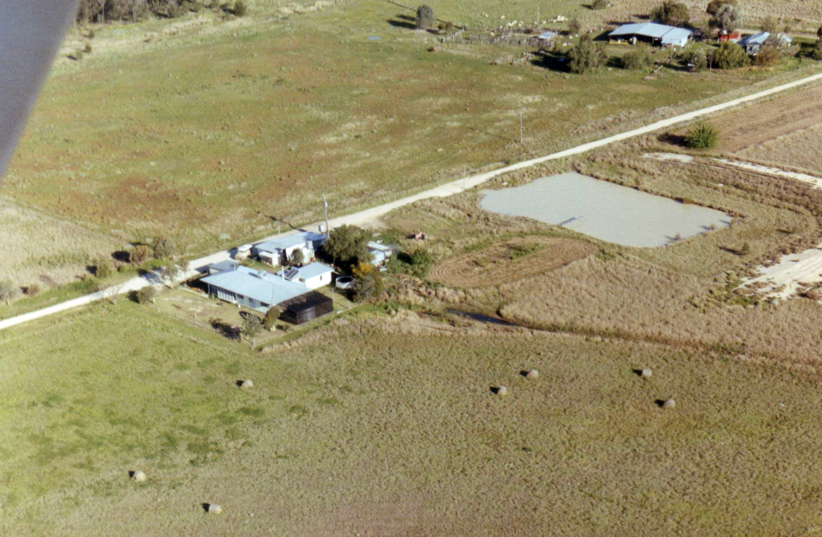
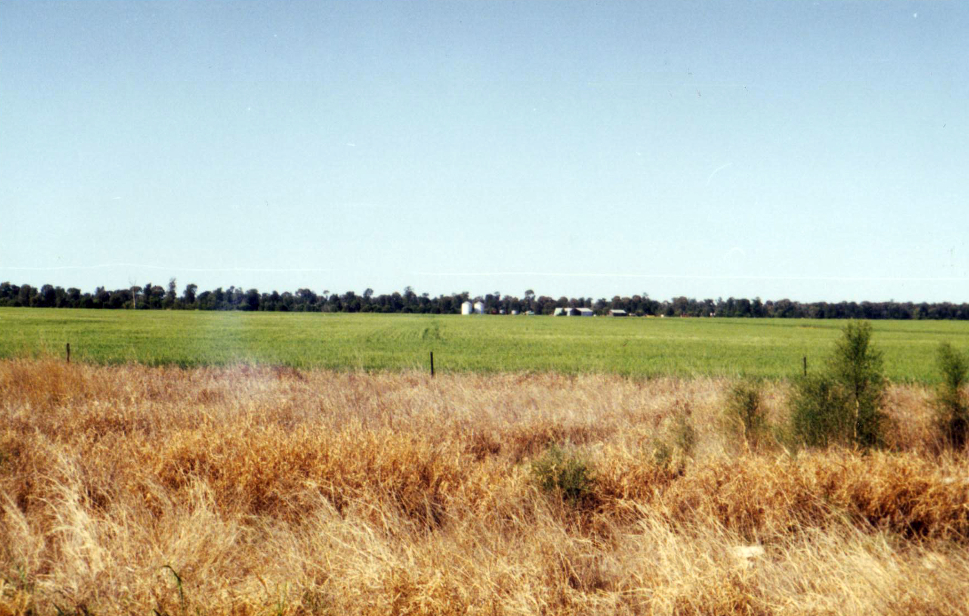

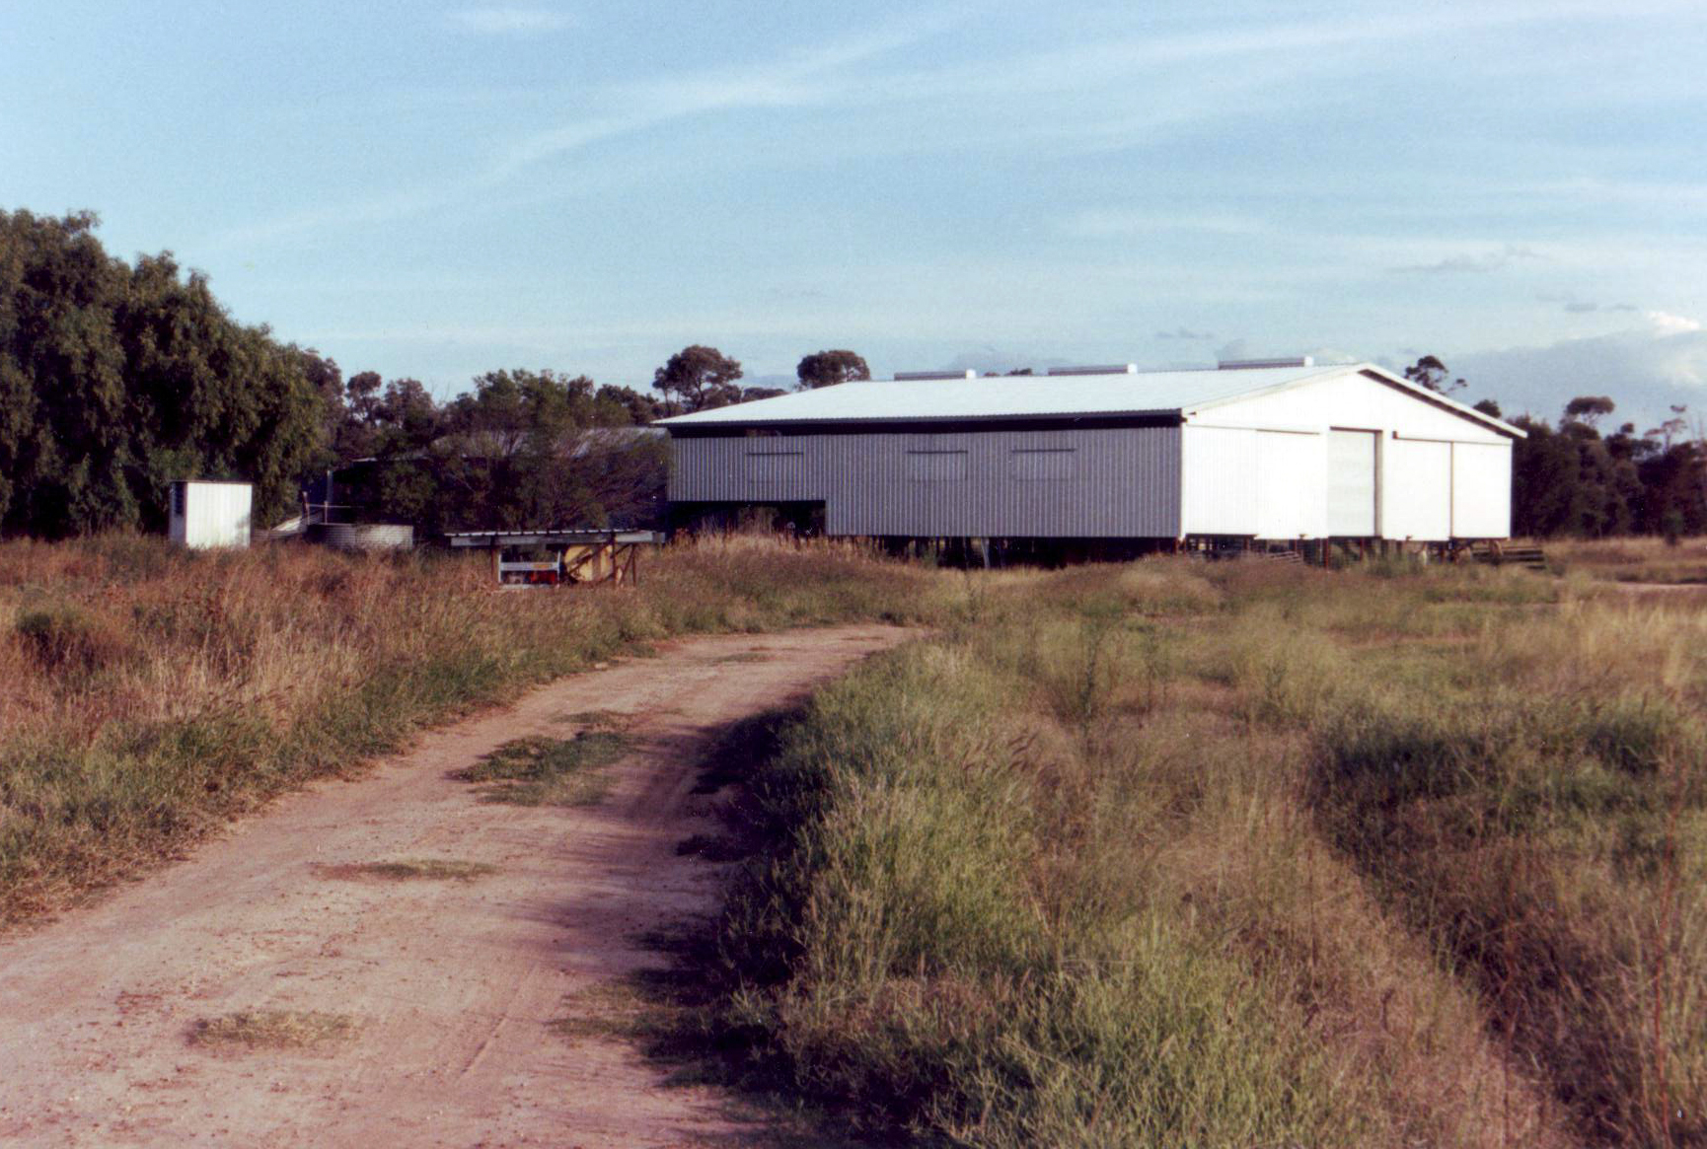
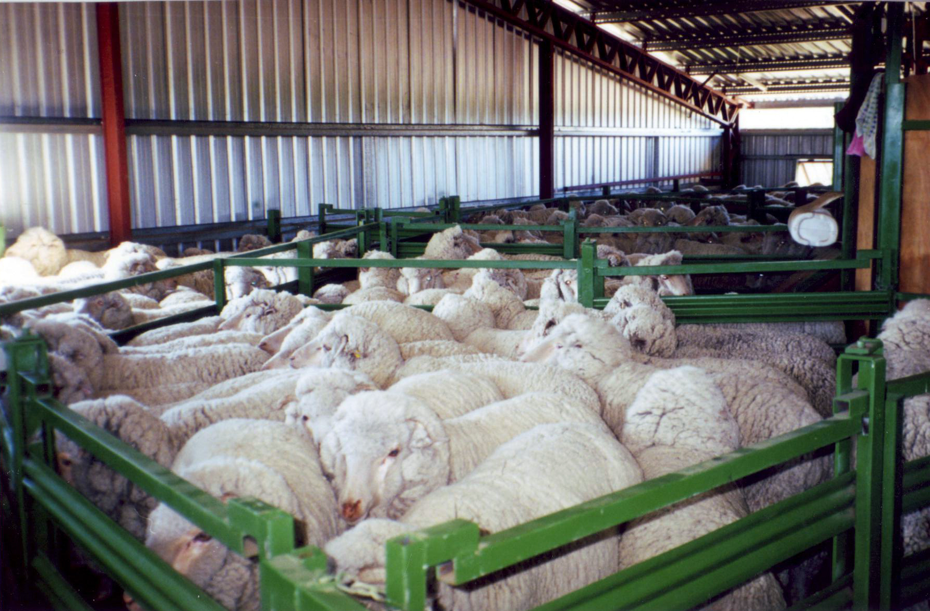
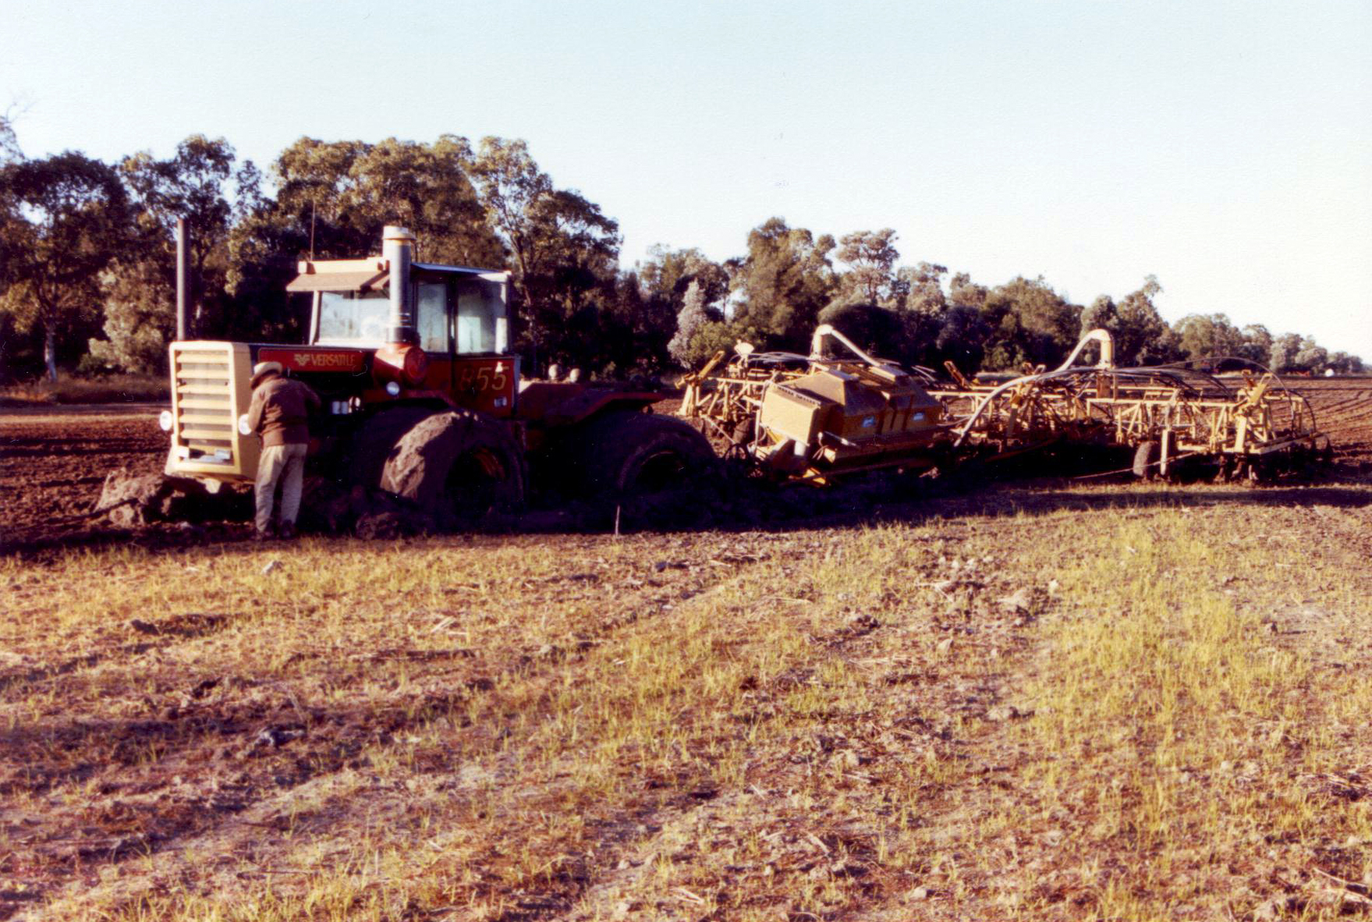
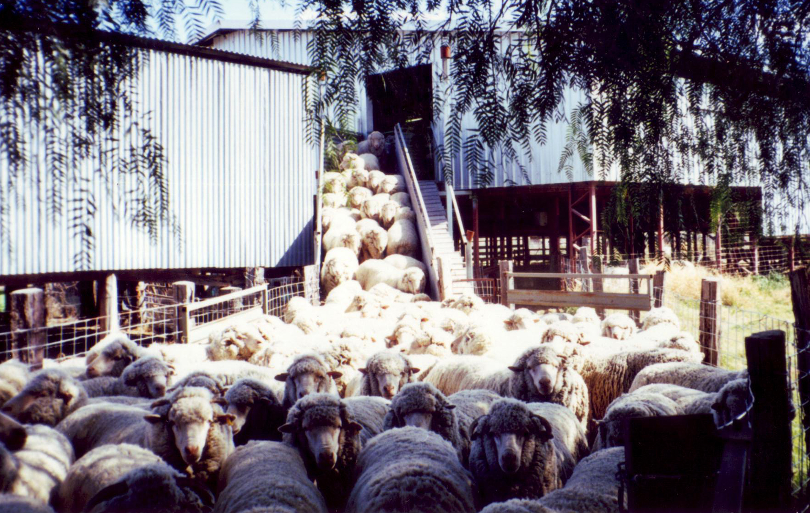
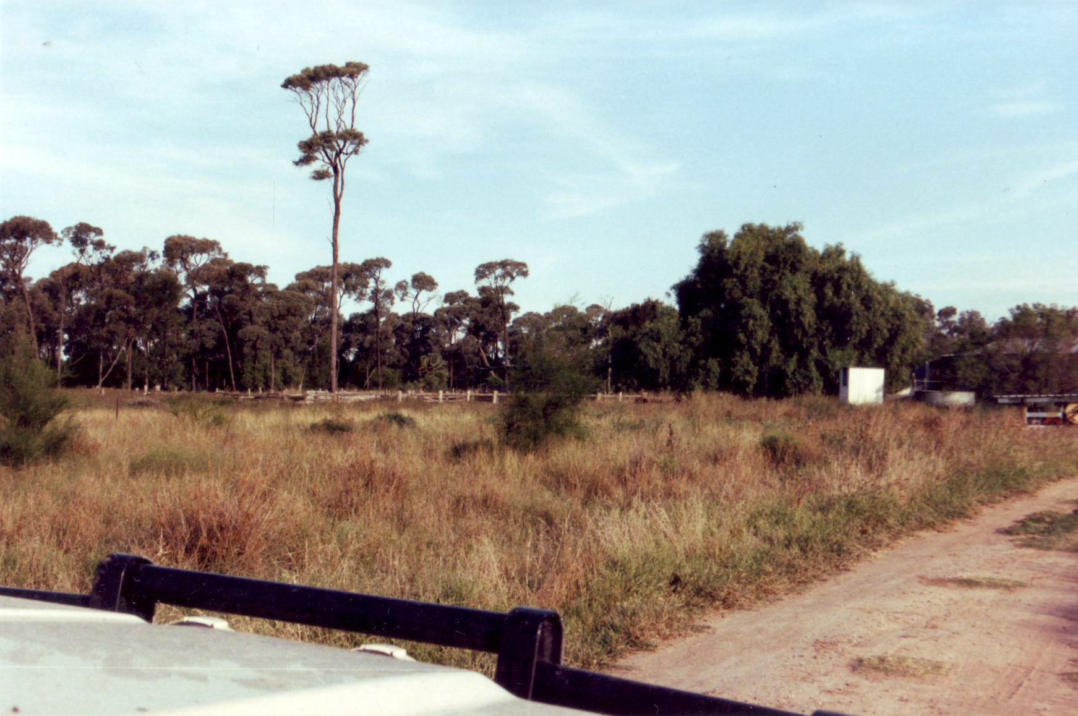
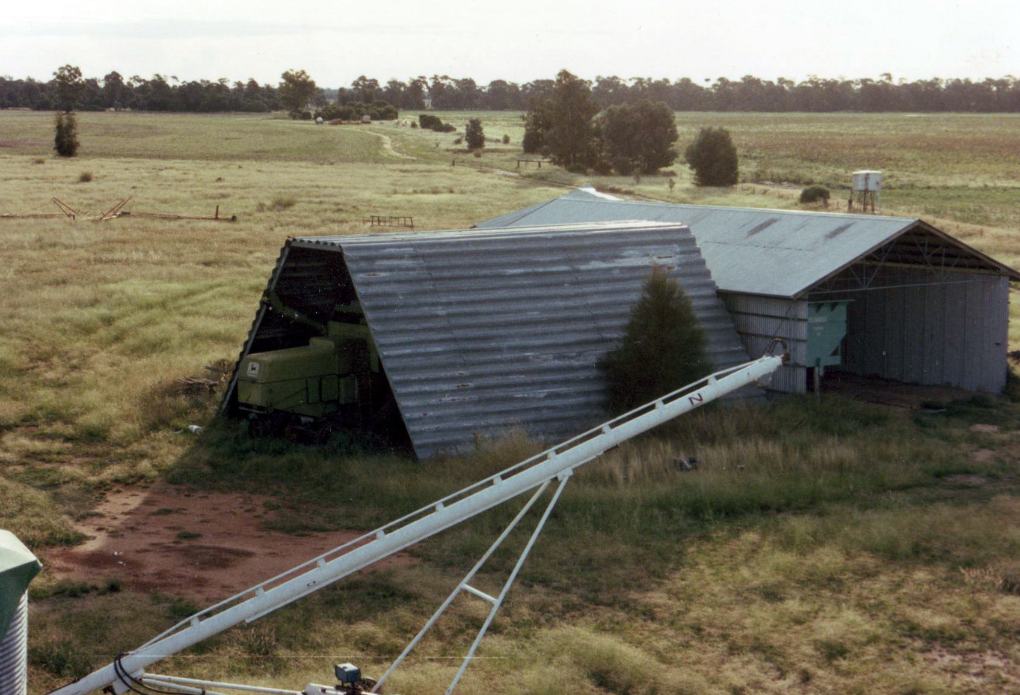

Slide 5
Personal Painful Experiences that Advance the Gospel
Tough times (or persecutions) are sometimes opportunity and means God uses for His purpose
Paul’s Imprisonment Advanced the Gospel
¹²....what has happened to me has really served to advance the gospel,
1. He was a witness to those who guarded him.
A conviction is something you would die for / go to jail for
Heard the gospel & saw his conviction (would never deny Jesus)
Jesus calls disciples of conviction, who will never deny Him. These are His witnesses.
Matthew 10: (ESV)
³⁷ Whoever loves father or mother more than me is not worthy of me, and whoever loves son or daughter more than me is not worthy of me. ³⁸ And whoever does not take his cross and follow me is not worthy of me. ³⁹ Whoever finds his life will lose it, and whoever loses his life for my sake will find it.

Slide 6
Personal Painful Experiences that Advance the Gospel
Tough times (or persecutions) are sometimes opportunity and means God uses for His purpose
Paul’s Imprisonment Advanced the Gospel
1. He was a witness to those who guarded him.
A conviction is something you would die for / go to jail for
Heard the gospel & saw his conviction (would never deny Jesus)
Jesus calls disciples of conviction, who will never deny Him. These are His witnesses.
2. Emboldened other disciples of Jesus to speak the word without fear
....most of the brothers, having become confident in the Lord by my imprisonment, are much more bold to speak the word without fear.
3. Letters he wrote from jail, are now Books of the New Testament

Slide 7
Personal Painful Experiences that Advance the Gospel
Tough times (or persecutions) are sometimes opportunity and means God uses for His purpose
Paul’s Imprisonment Advanced the Gospel
1. He was a witness to those who guarded him.
A conviction is something you would die for / go to jail for
Heard the gospel & saw his conviction (would never deny Jesus)
Jesus calls disciples of conviction, who will never deny Him. These are His witnesses.
2. Emboldened other disciples of Jesus to speak the word without fear
3. Letters he wrote from jail, are now Books of the New Testament
Faith to understand how Bad can work for Good
A worldly perspective looks for temporal blessings (things that will pass away)
An eternal perspective looks for things of eternal significance
When we are ‘In Christ’, what’s good for Christ & Gospel, is good for us (even prison or death)
Romans 8:28 (ESV) ²⁸ And we know that for those who love God all things work together for good, for those who are called according to his purpose.

Slide 8
Tough times (or persecutions) are sometimes opportunity and means God uses for His purpose
Paul’s Imprisonment Advanced the Gospel
1. A witness to those who guarded him.
2. Emboldened other disciples of Jesus to speak the word without fear
3. Letters he wrote from jail, are now Books of the New Testament
Faith to understand how Bad can work for Good
A worldly perspective looks for temporal blessings (things that will pass away)
An eternal perspective looks for things of eternal significance
When we are ‘In Christ’, what’s good for Christ & Gospel, is good for us (even prison or death)
The Gospel, not always preached with right motivation (envy; rivalry; ambition; insincere)
Paul rejoices because through good motives and bad, the Gospel is being preached
Some respond to a false gospel & aren’t saved. Others respond to God’s word and are saved
A person’s salvation is a response to God (not a man) & to follow Jesus (not a man).
We rejoice when, despite the motivation of the preacher, a person is truly born again
¹⁵ Some indeed preach Christ from envy and rivalry, but others from good will. ¹⁶ The latter do it out of love, knowing that I am put here for the defence of the gospel. ¹⁷ The former proclaim Christ out of selfish ambition, not sincerely but thinking to afflict me in my imprisonment. ¹⁸ What then? Only that in every way, whether in pretence or in truth, Christ is proclaimed, and in that I rejoice.

Slide 9
Tough times (or persecutions) are sometimes opportunity and means God uses for His purpose
Paul’s Imprisonment Advanced the Gospel
1. A witness to those who guarded him.
2. Emboldened other disciples of Jesus to speak the word without fear
3. Letters he wrote from jail, are now Books of the New Testament
Faith to understand how Bad can work for Good
A worldly perspective looks for temporal blessings (things that will pass away)
An eternal perspective looks for things of eternal significance
When we are ‘In Christ’, what’s good for Christ & Gospel, is good for us (even prison or death)
The Gospel, not always preached with right motivation (envy; rivalry; ambition; insincere)
Paul rejoices because through good motives and bad, the Gospel is being preached
Some respond to a false gospel & aren’t saved. Others respond to God’s word and are saved
A person’s salvation is a response to God (not a man) & to follow Jesus (not a man).
We rejoice when, despite the motivation of the preacher, a person is truly born again
1. Are my motivations pure? (from Love ) Or are my motivations selfish?
2. Be glad when the Gospel is preached,,,,,,, But be careful which horse we hitch our cart to
Follow Christ & not a person with insincere motives

